Slide 1

Jawaharlal Darda Institute Of Engineering and Technology, Yavatmal
Project On
“WEB SERVER BASED HOME AUTOMATION SYSTEM USING INTERNET OF THINGS”
By
1. Hitesha Gotecha 2. Aniket Marwade
3. Abhijeet Gurnule 4. Nayan Patel
5. Rohit Darekar 6. Janvi Dhomane
7. Rati Gaddamwar 8. Ritesh Rekhate
Under the Guidance of
Prof. A. N. Kazi
Department of Computer Science and Engineering
JDIET, Yavatmal

Slide 2

SUMMARY
INTRODUCTION
LITRATURE REVIEW
SYSTEM ANALYSIS
REQUIREMENT ANALYSIS
SYSTEM DESIGN
IMPLEMENTATION
CONCLUSION

Slide 3
What is Home Automation?
Wireless Home Automation system(WHAS) using IoT is a system that uses computers or mobile devices to control basic home functions and features automatically through internet from anywhere around the world.
INTRODUCTION
What is Our Moto?
It is meant to save the electric power and human energy.
Easy Installation And Reduced Installation Costs.
Integration of mobile devices.

Slide 4
What is the Purpose of this Project?
The proposed home automation system can control the following appliance:
Lights on/off
Fan on/off
Regulate the appliances.
On/off different appliances.
Detect weather the appliances are on/off.
LITRATURE REVIEW

Slide 5
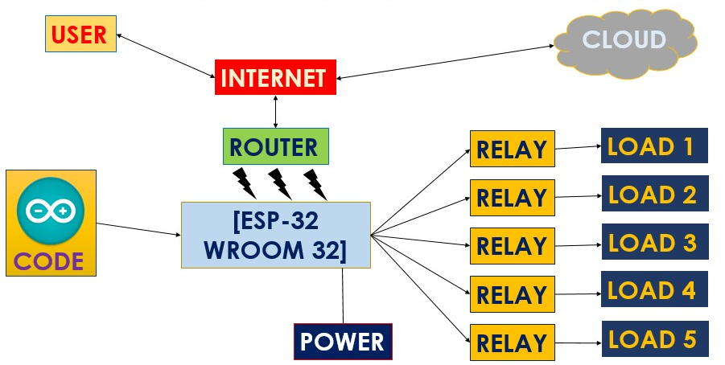
FLOW OF SYSTEM ANALYSIS

Slide 6
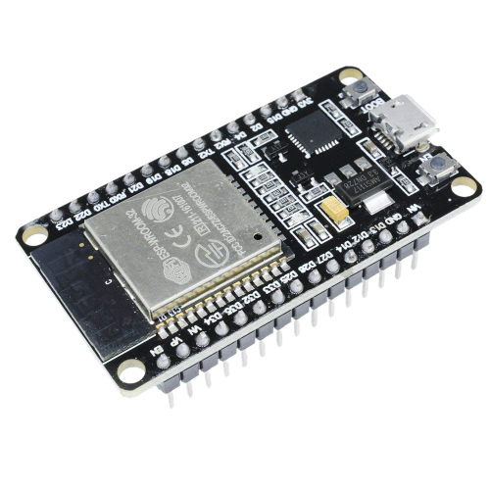
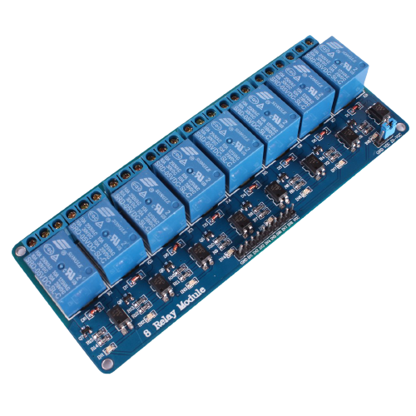
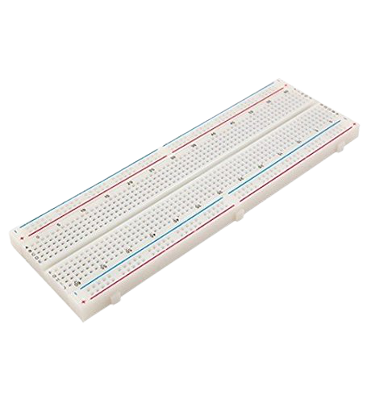
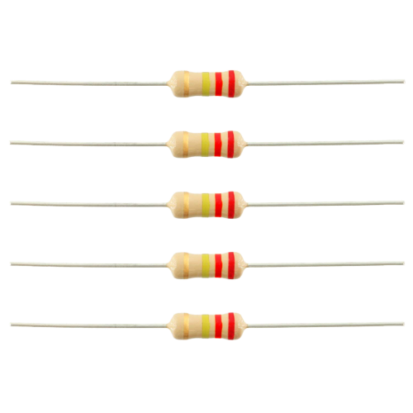
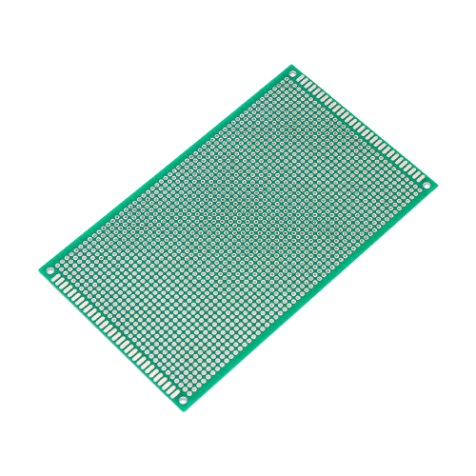
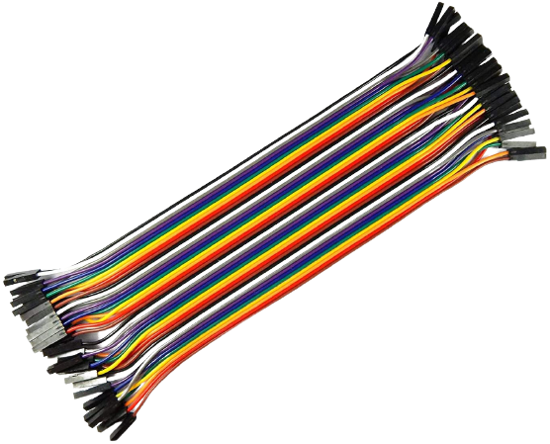
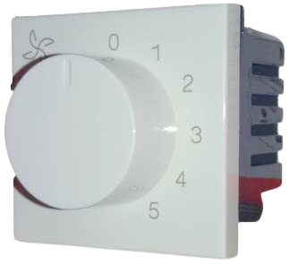

REQUIREMENT ANALYSIS
ESP32
8-Channel-Relay
Bread Board
Resistor
Jumper Cables
Prototype Board
Regulator
Bulb

Slide 7
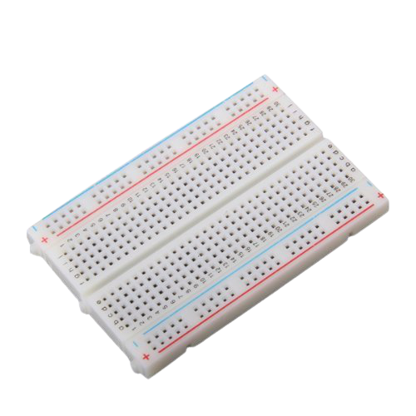
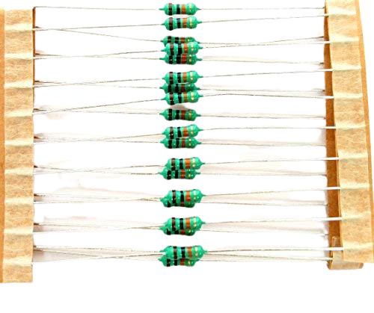
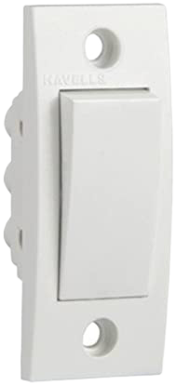
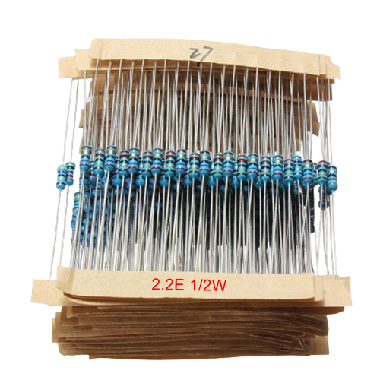

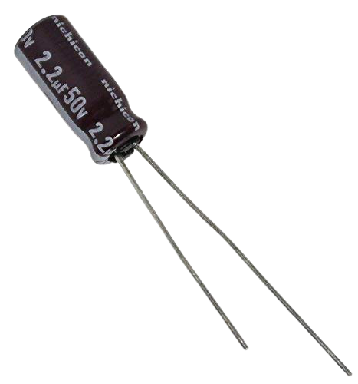
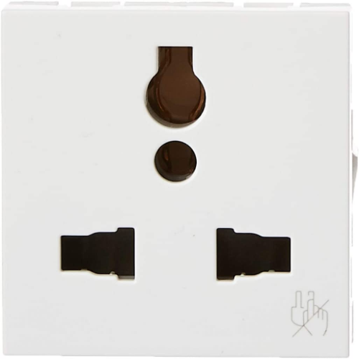
Small Bread Board
10k ohm Resistors
Button
2.2 Ohm Resistor
3.3uF 250V Capacitor
2.2uf 250V Capacitor
Socket

Slide 8


SOFTWARE REQUIREMENT
1)
2)
Blynk was designed for the Internet of Things. It can control hardware remotely, it can display sensor data, it can store data, vizualize it and do many other cool things.
There are three major components in the platform:
Blynk App - allows to you create amazing interfaces for your projects using various widgets we provide.
Blynk Server - responsible for all the communications between the smartphone and hardware. You can use our Blynk Cloud or run your private Blynk server locally. It’s open-source, could easily handle thousands of devices and can even be launched on a Raspberry Pi.
Blynk Libraries - for all the popular hardware platforms - enable communication with the server and process all the incoming and outcoming commands.
The open-source Arduino Software (IDE) makes it easy to write code and upload it to the board. This software can be used with any Arduino board.

Slide 9
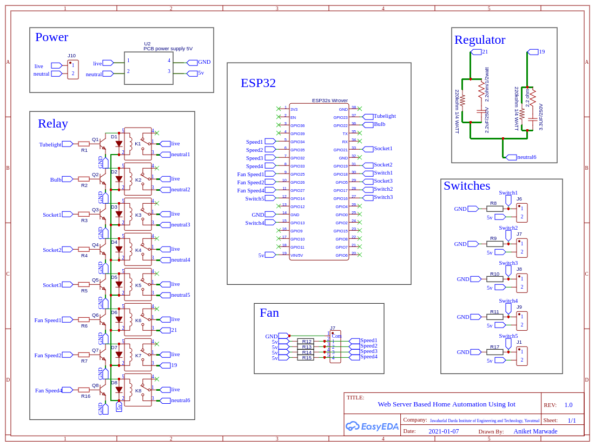
SYSTEM DESIGN

Slide 10
Arduino Ide:
Download the latest version of the Arduino Ide.
Go to the folder: \Downloads
Look for Arduino Ide file and Install it.
Blynk Library:
Open Arduino Ide.
Go to Sketch:
Go to Include Library
Go to Manage Libraries
Search for Blynk in search box
Select latest version in Select Version box and click Install
ESP32 Board:
Open Arduino Ide.
Go to Files:
Go to Preferences
Go to Additional Boards Manager URLs: and Paste- https://raw.githubusercontent.com/espressif/arduino-esp32/gh-pages/package_esp32_index.json their and click Ok.
Now go to Tools:
Go to Boards:
Go to Boards Manager
Search for esp32 in search bar
Select latest version in Select Version box and click Install
IMPLEMENTATION

Slide 11
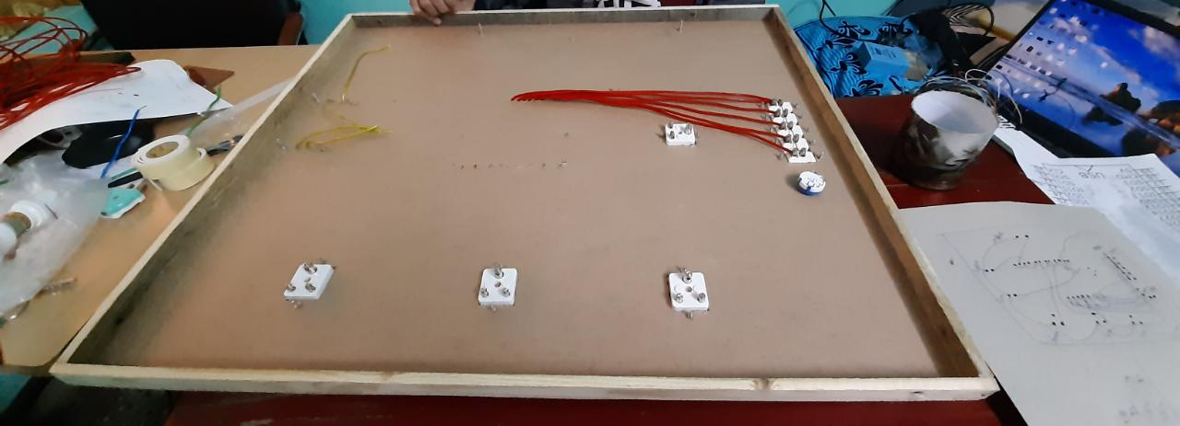
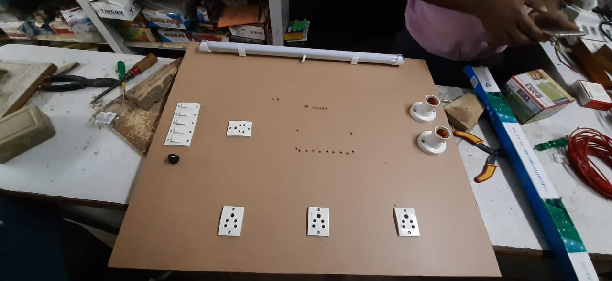
Back Side
IMAGES
Front Side

Slide 12
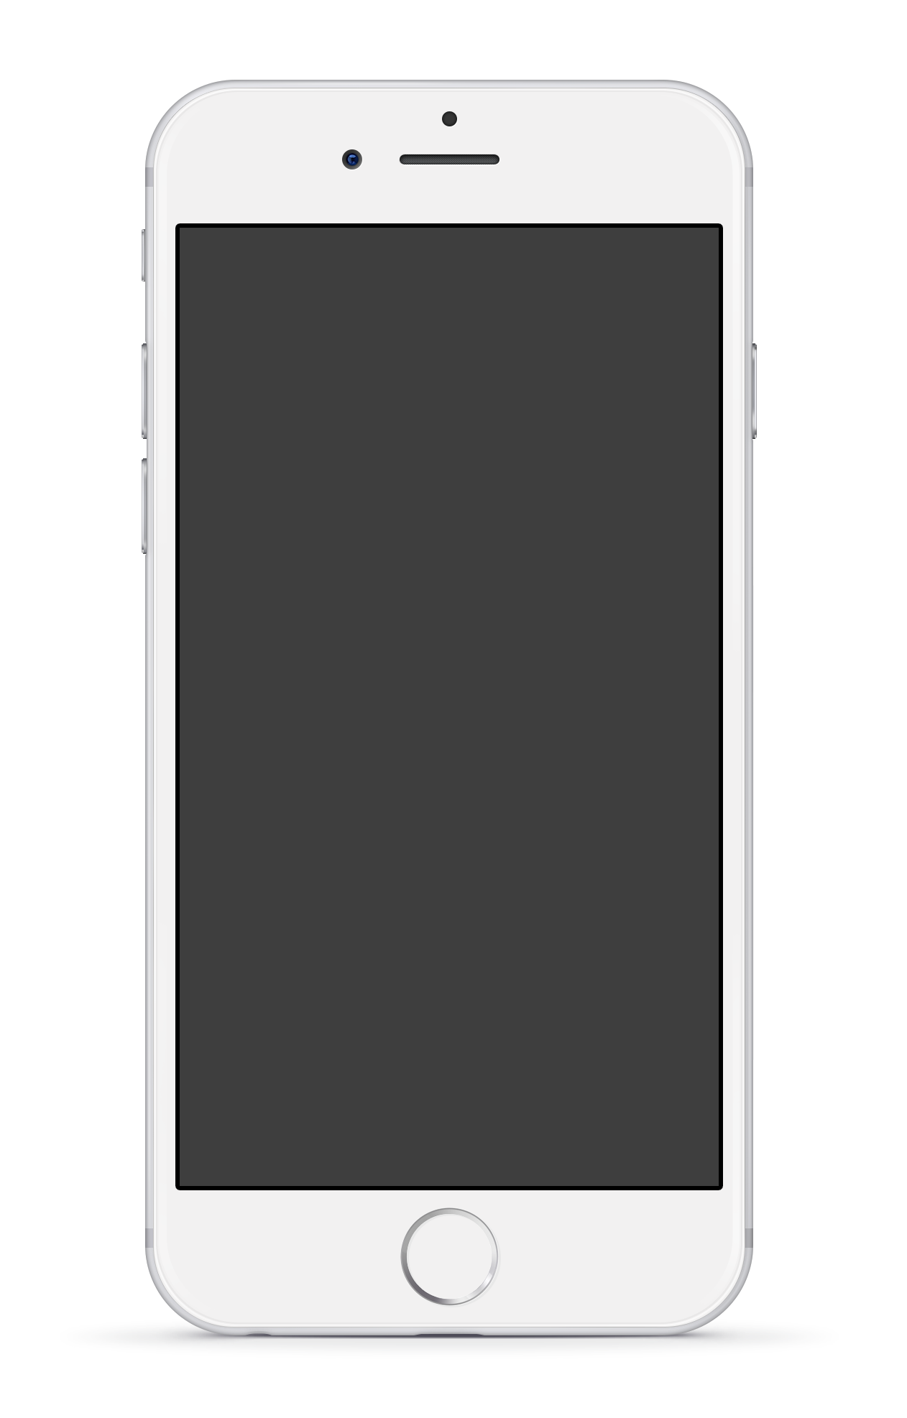
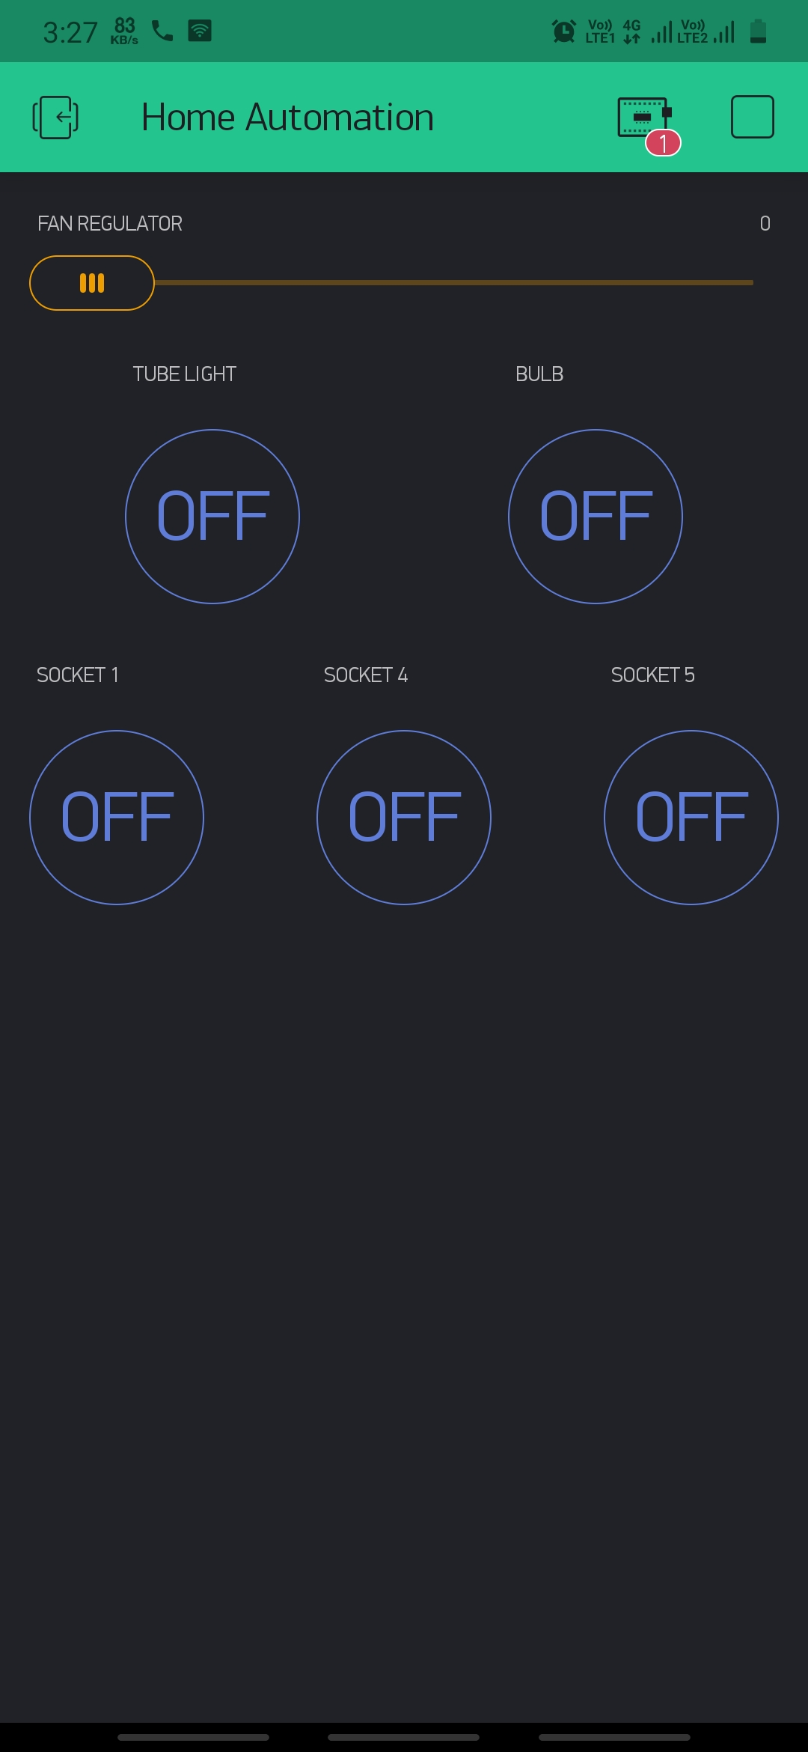
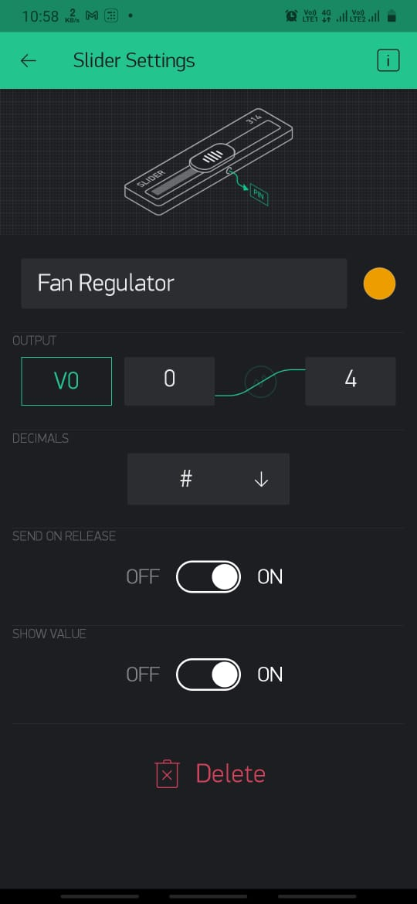
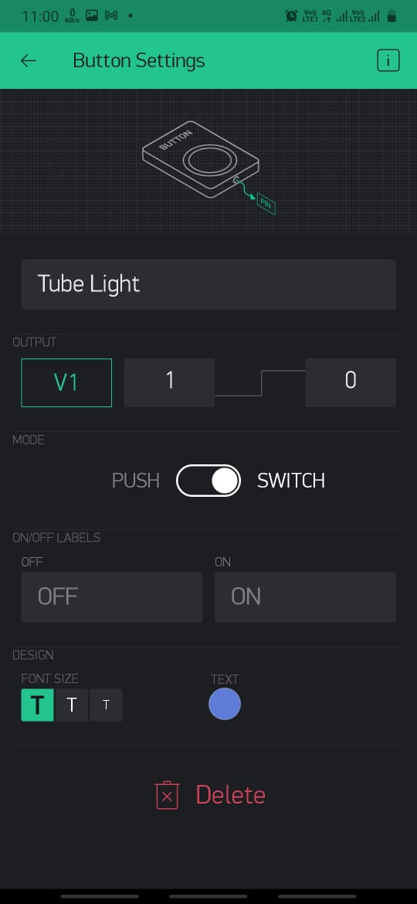
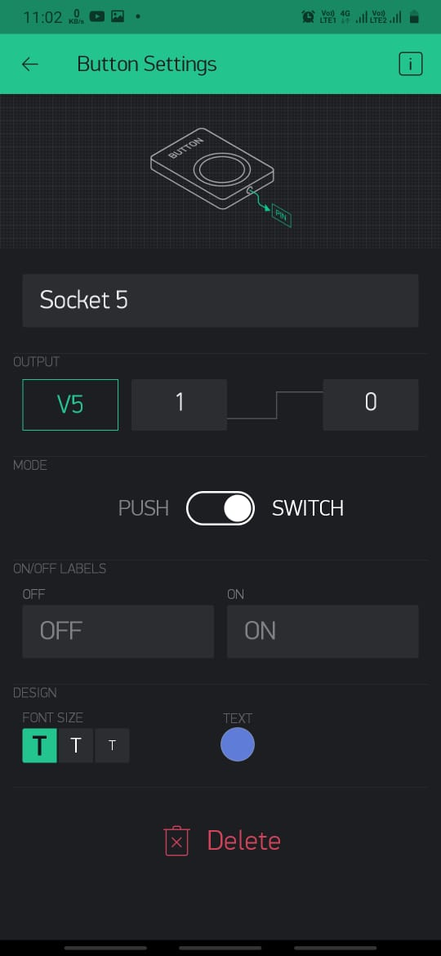
MOBILE INTERFACE

Slide 13
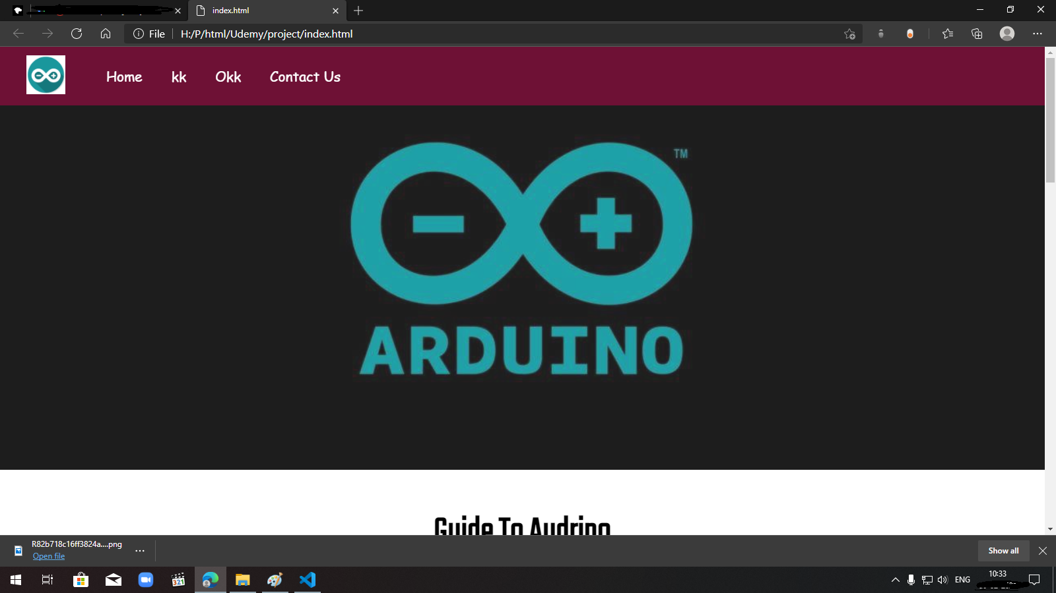
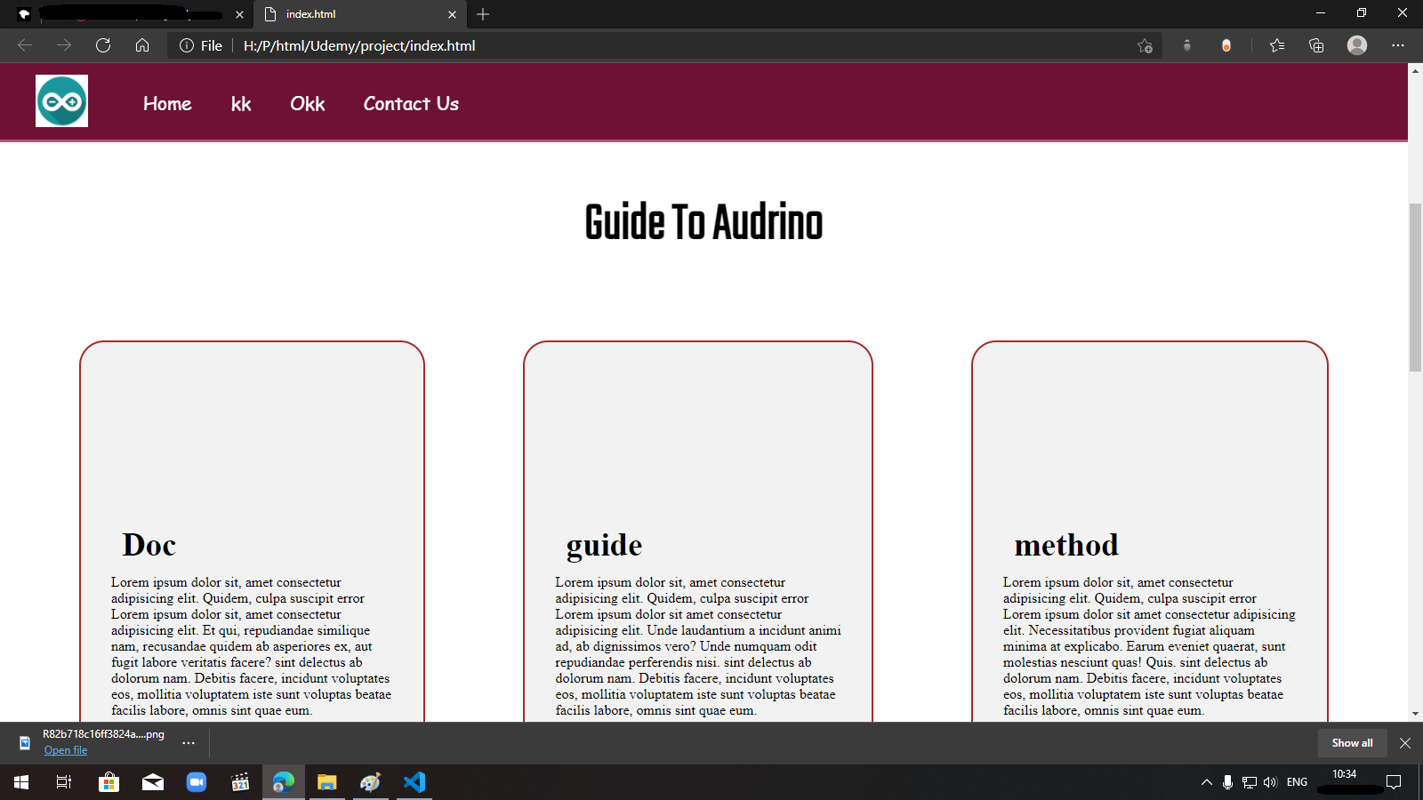
WEBSITE INTERFACE

Slide 14
CONCLUSION
The home automation using Internet of Things has been experimentally proven to work satisfactorily by connecting simple appliances to it and the appliances were successfully controlled remotely through internet as well as manually.
The designed system helps user as per their convenience and easy to control.

